Slide 1
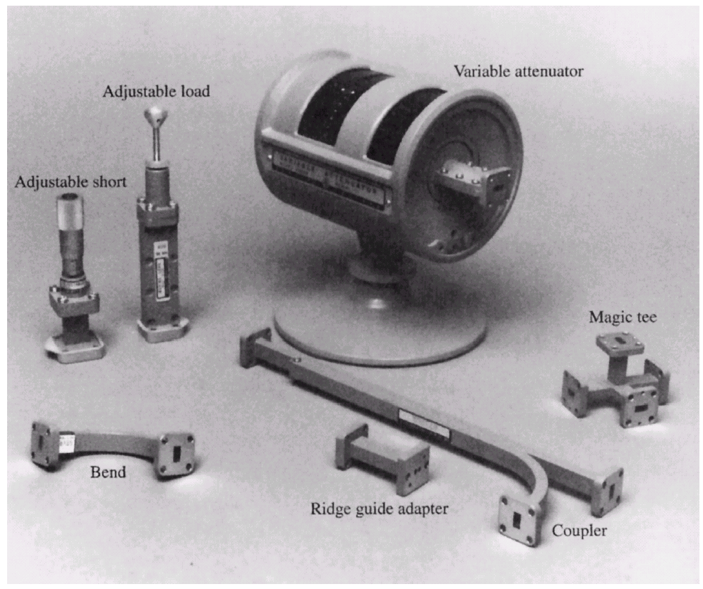
§4.2 Rectangular waveguide
Photograph of Ka-band rectangular waveguide components. Clockwise from top: a variable attenuator, and E-H (magic) tee junction, a directional coupler, an adaptor to ridge waveguide, an E-plane swept bend, an adjustable short, and a sliding matched load.

Slide 2
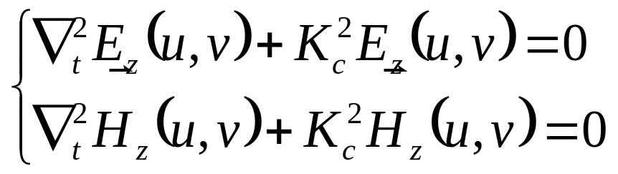
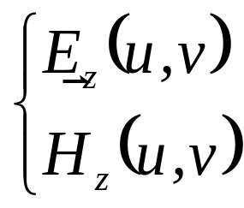
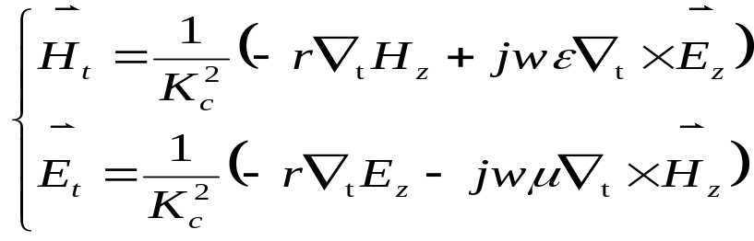
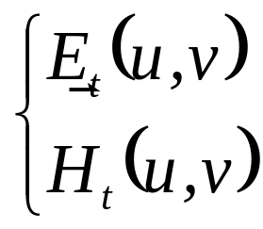
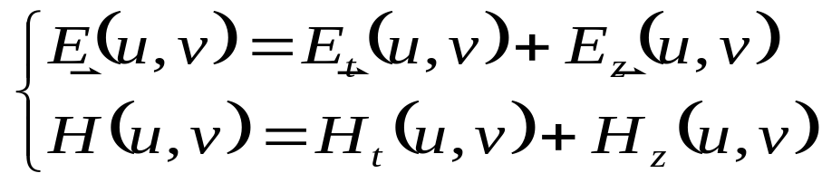
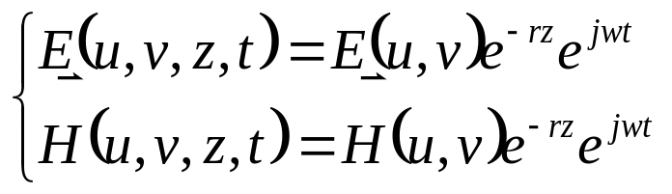
§4.2 Rectangular waveguide

Slide 3
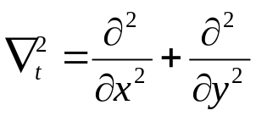
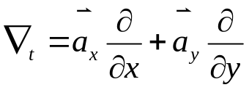
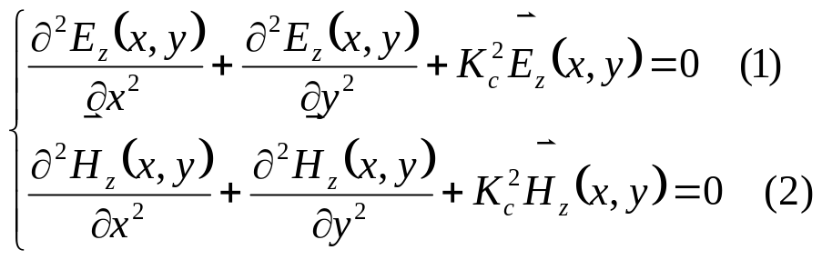
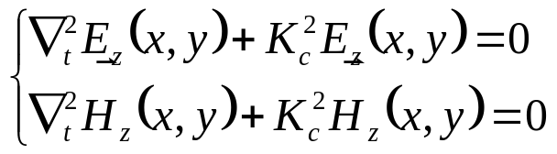

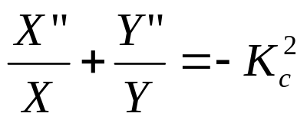
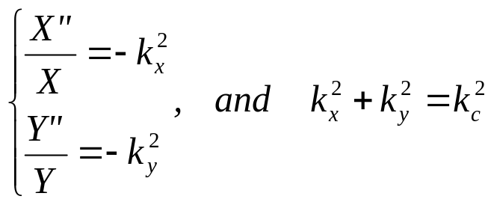
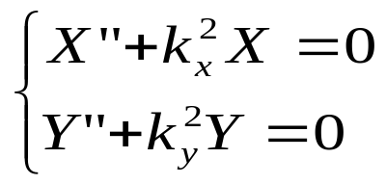
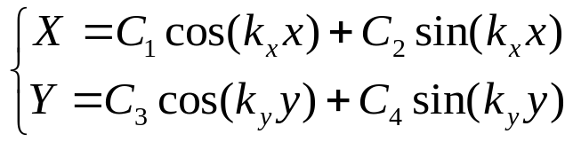
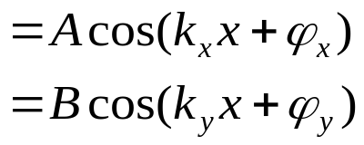
§4.2 Rectangular waveguide
Solve the reduced Helmholtz equation
in Cartesian Coordinates
Let E_{z}(x,y)=X(x)Y(y)
Divided by XY
Constant

Slide 4


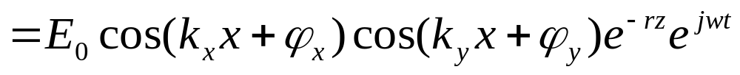
§4.2 Rectangular waveguide

Slide 5
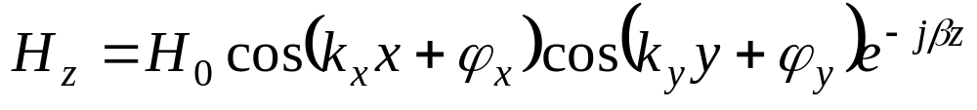




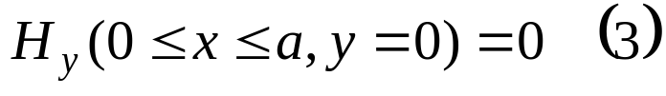
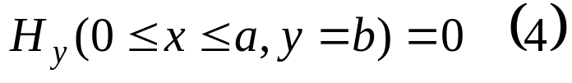
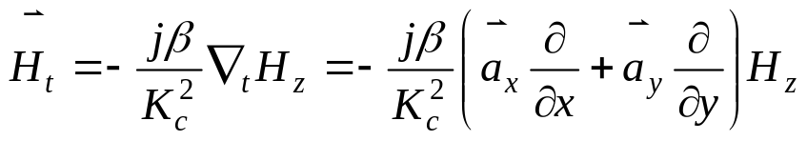
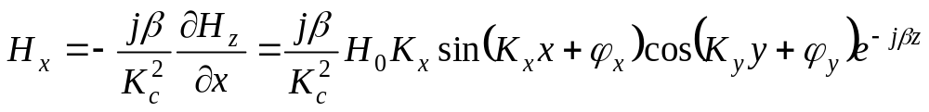
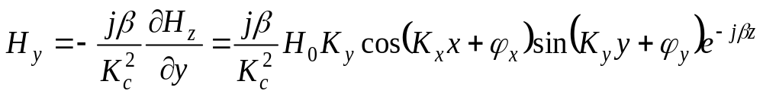
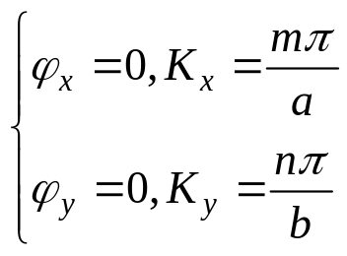
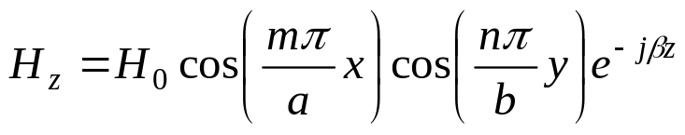
§4.2 Rectangular waveguide
1. TE wave
y
b
x
z
a
H_{z} → H_{t}

Slide 6
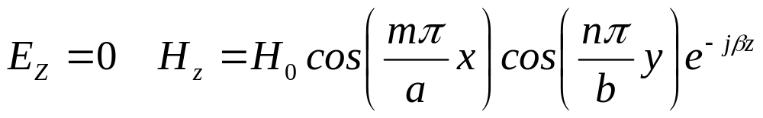

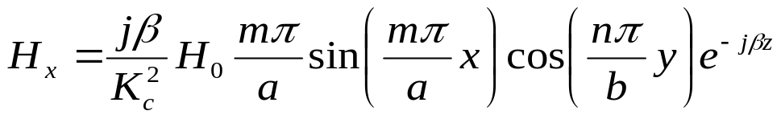
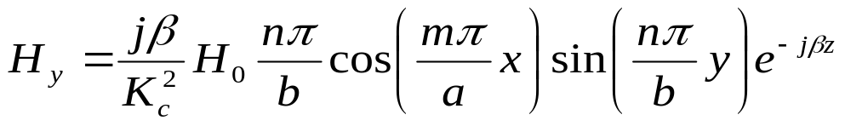
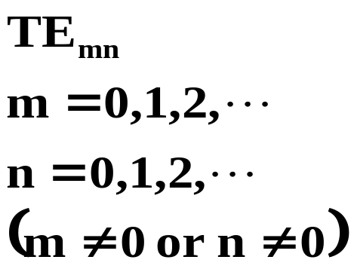
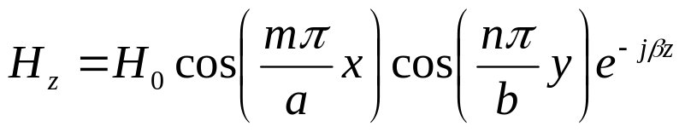
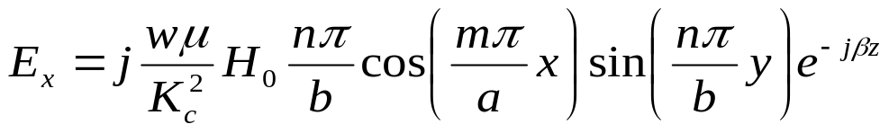
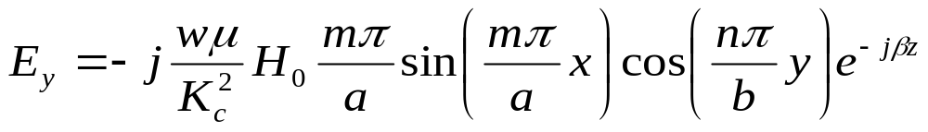

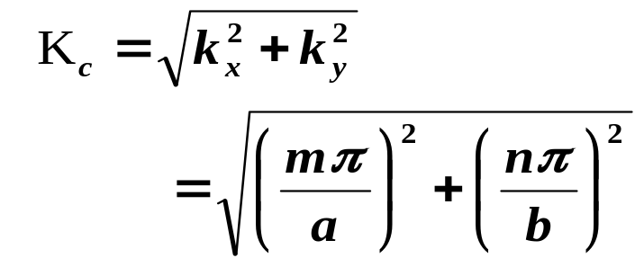
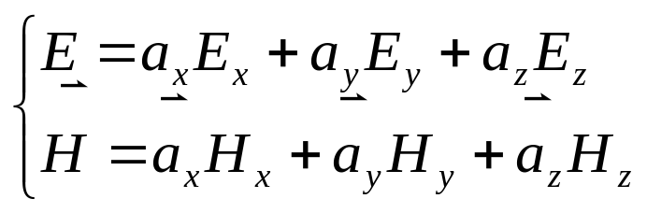
§4.2 Rectangular waveguide——1 TE wave

Slide 7
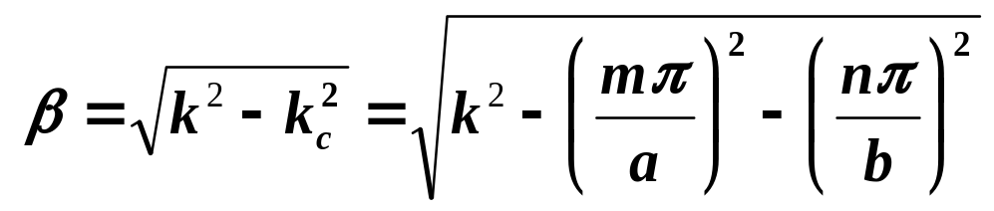

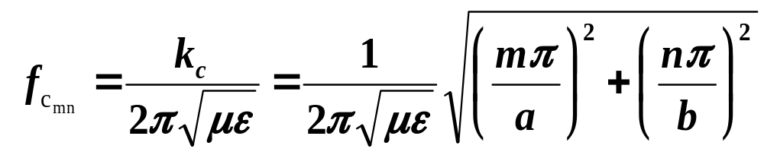
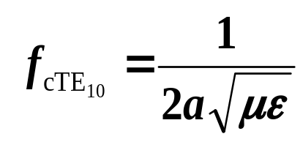
§4.2 Rectangular waveguide——1 TE wave
Propagation constant
→ a propagation mode
Each mode has a cutoff frequency
Dominant mode： the mode with the lowest cutoff frequency
if a>b, TE₁₀ is the dominant TE mode

Slide 8
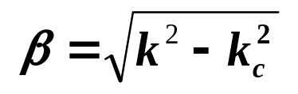
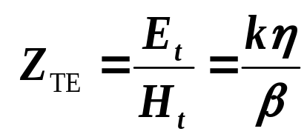
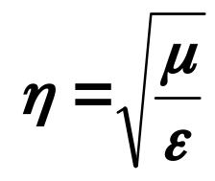
§4.2 Rectangular waveguide——1 TE wave
Cutoff/ evanescent mode：
modes with fc>f will lead to an imaginary β, meaning that all field components will decay exponentially away from the source of excitation
Overmoded guide
more than one mode is propagating
Wave impedance

Slide 9
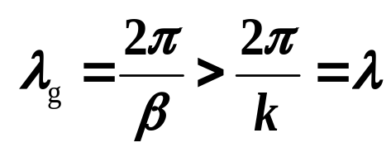
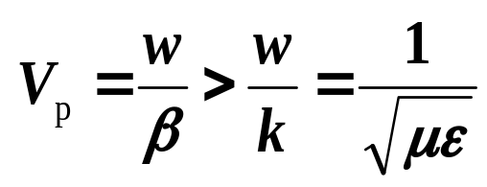
§4.2 Rectangular waveguide——1 TE wave
Guide wavelength
the distance between two equal phase planes along the waveguide
greater than the wavelength of a plane wave in the filling medium
Phase velocity
greater than the speed of light( plane wave) in the filling medium
Attenuation

Slide 10

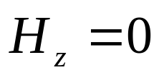
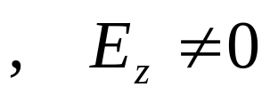






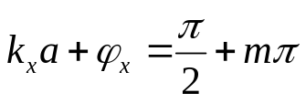
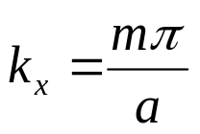

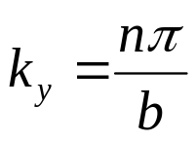
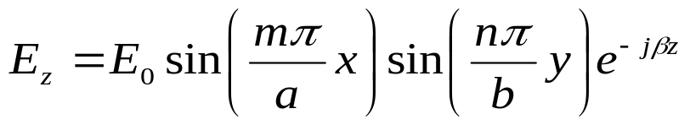
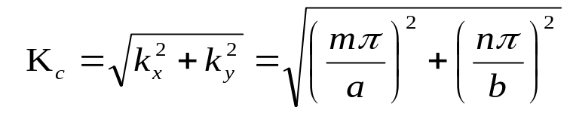
2. TM wave
§4.2 Rectangular waveguide
Perfect conductor
y
b
x
z
a
(1)
(2)
(3)
(4)

Slide 11

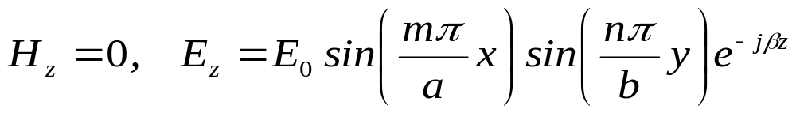













§4.2 Rectangular waveguide –2.TM Wave

Slide 12








§4.2 Rectangular waveguide –2.TM wave

Slide 13


§4.2 Rectangular waveguide –2.TM wave
Propagation constant
Cutoff frequency
TM₁₁ is the lowest order TM mode to propagate

Slide 14



§4.2 Rectangular waveguide
3. Summary of Results for rectangular waveguide
Cutoff wavelength

Slide 15


§4.2 Rectangular waveguide
if a>2b
1)λ≥2a
cutoff
2）a≤λ≤2a
TE₁₀
3）λ<a
Overmoded

Slide 16






§4.2 Rectangular waveguide
Guide wavelength and phase constant
Phase velocity and group velocity
Wave impedance

Slide 17

§4.2 Rectangular waveguide
Attenuation
Attenuation of various modes in a rectangular brass waveguide with a = 2.0 cm.

Slide 18










§4.2 Rrectangular waveguide
For TE₁₀

Slide 19








§4.2 Rectangular waveguide

Slide 20








§4.2 Rectangular waveguide
Power flow on the guide for the TE10 mode
Emax @ x=a/2

Slide 21








§4.2 Rectangular waveguide
P_{br}
Filled with air, E_{br}＝30kV/cm，
better between
0.5<λ/λ_{c}<0.9，
→ a<λ<1.8a
λ/λ_{C}
P_{br}’＝ P_{br}/s

